Slide 1
New energy industry ESG performance evaluation and analysis
Group member: Wang Yihan, Lin Keni, Ji Xuanchi, Chen Shu, Tan Linfeng, Xie Yihui, Dai Luren, Ding Yulong

Slide 2
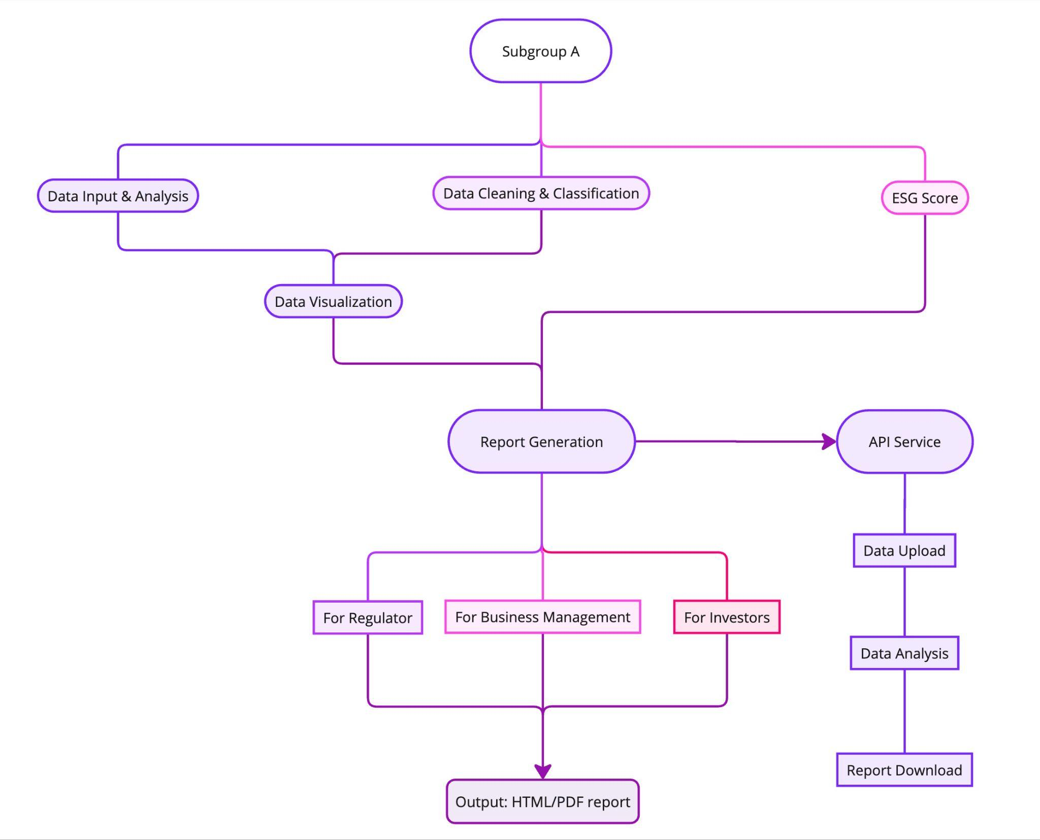
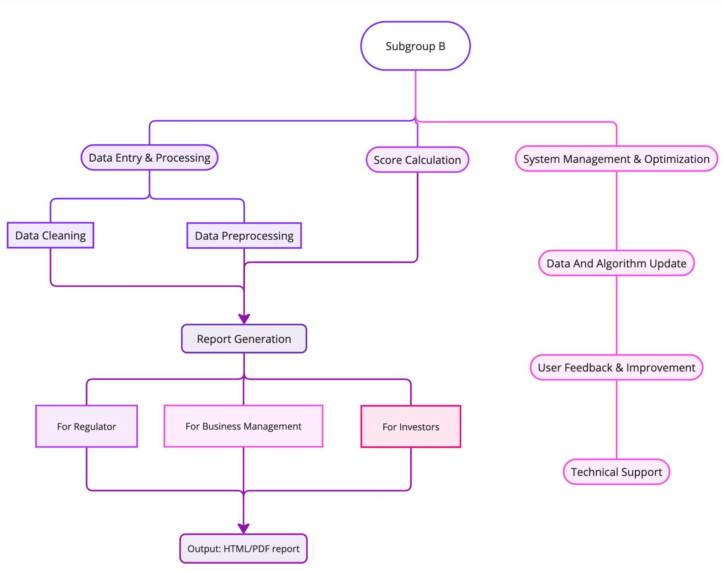
New energy industry ESG performance evaluation and analysis
Data collection and data preprocessing

Slide 3
Project Overview
01
New energy industry ESG report background:
ESG reports in the new energy industry focus on environmental protection, social responsibility, and good governance. They highlight important areas like carbon reduction and clean energy development. These reports help companies measure their sustainability and show investors their commitment to tackling climate change.
Main objectives of the project:
Automatically extract ESG information from unstructured reports and analyze ESG performance in selected industries.
By using advanced natural language processing (NLP) and data analysis, this project aims to make ESG data extraction easier, improve data quality, and provide useful insights for corporate sustainability.

Slide 4
Collaborative Phase Summary
02
Data collection：
CDP data
Global Reporting Initiative (GRI) standards
Core ESG indicators recommended by the Singapore Exchange (SGX)
Annual ESG or sustainability report published on the company's website.
Preprocessing step：
Cleaned text and tokenized sentences to prepare data for NLP.
Manually annotated ESG metrics (e.g., "Gender Diversity", "Energy Consumption").
Built a labeled dataset for training and testing.
Illustrative Workflow:
Extracted text from ESG reports PyPDF2.
Cleaned and segmented text nltk.
Tagged ESG-specific data for model development.

Slide 5
Subgroup A Objectives
03
Develop NLP Algorithms for ESG Data Extraction:
Build a pipeline to transform unstructured PDF reports into structured data, focusing on text extraction and cleaning.
Implement sentence segmentation and text parsing to generate high-quality data for analysis.
Ensure the Accuracy of Data Extraction:
Apply structured data generation methods to ensure traceable and reliable information.
Enhance Algorithm Adaptability:
Support transfer learning to handle diverse ESG reporting standards and adapt to different industry contexts.

Slide 6
Subgroup A: Key Findings
04
End-to-End Pipeline from PDFs to Structured Data:
Successfully extracted text from PDF files using PyPDF2 combined with regex for cleaning irrelevant information.
Utilized nltk for sentence segmentation, converting unstructured text into meaningful sentence units.
Data Validation and Metric Alignment:
Leveraged flatten_json to parse nested JSON into structured tables, ensuring alignment with core ESG metrics.
Verified data coverage against SGX’s key ESG indicators.
Potential for Model Expansion:
Loaded pre-trained language models to explore cross-language and cross-industry adaptability.
Established the foundation to support additional data types (e.g., HTML reports).

Slide 7
Subgroup A: Recommendations
05
Optimize PDF Processing Efficiency:
Enhance computational efficiency and storage management for batch data processing workflows.
Improve Algorithm Robustness:
Combine sentence segmentation with classification techniques to improve accuracy in extracting ESG-specific information and understanding context.
Enable Greenwashing Detection:
Integrate sentiment analysis and semantic consistency checks to identify misleading or inconsistent ESG claims.
Expand to Multilingual Contexts:
Develop multilingual capabilities to accommodate the growing diversity of international ESG reports.

Slide 8
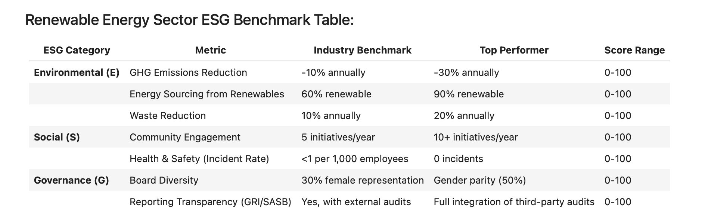
Subgroup B Objectives
06
ESG performance evaluation and analysis
Develop a set of scoring criteria based on SGX core ESG indicators
The score is scored after subdivision based on the three dimensions of ESG. (The weight of the new energy industry environment module will be higher)
Define ESG indicators and weights specific to the new energy industry.
Standardize the score of the indicator

Slide 9
Subgroup B: Key Findings
07
Insights on ESG performance trends and patterns.
Analysis of ESG scores for companies and sub-industries：
Wind and solar companies excel in environmental performance (carbon reduction, resource efficiency), while energy storage companies have challenges in waste management and supply chain transparency. There is still room for improvement in governance transparency and accountability mechanisms across the industry.
ESG strengths and weaknesses identification：
The new energy sector has significant advantages in environmental protection (carbon reduction, clean energy), but still faces challenges in governance transparency, supply chain compliance and waste management.
The relationship between ESG and financial indicators：
New energy companies with high ESG score usually have low volatility and low capital cost, showing strong market competitiveness; However, there are differences in performance on stock price correlation, and the financial impact varies by company and sub-sector.

Slide 10
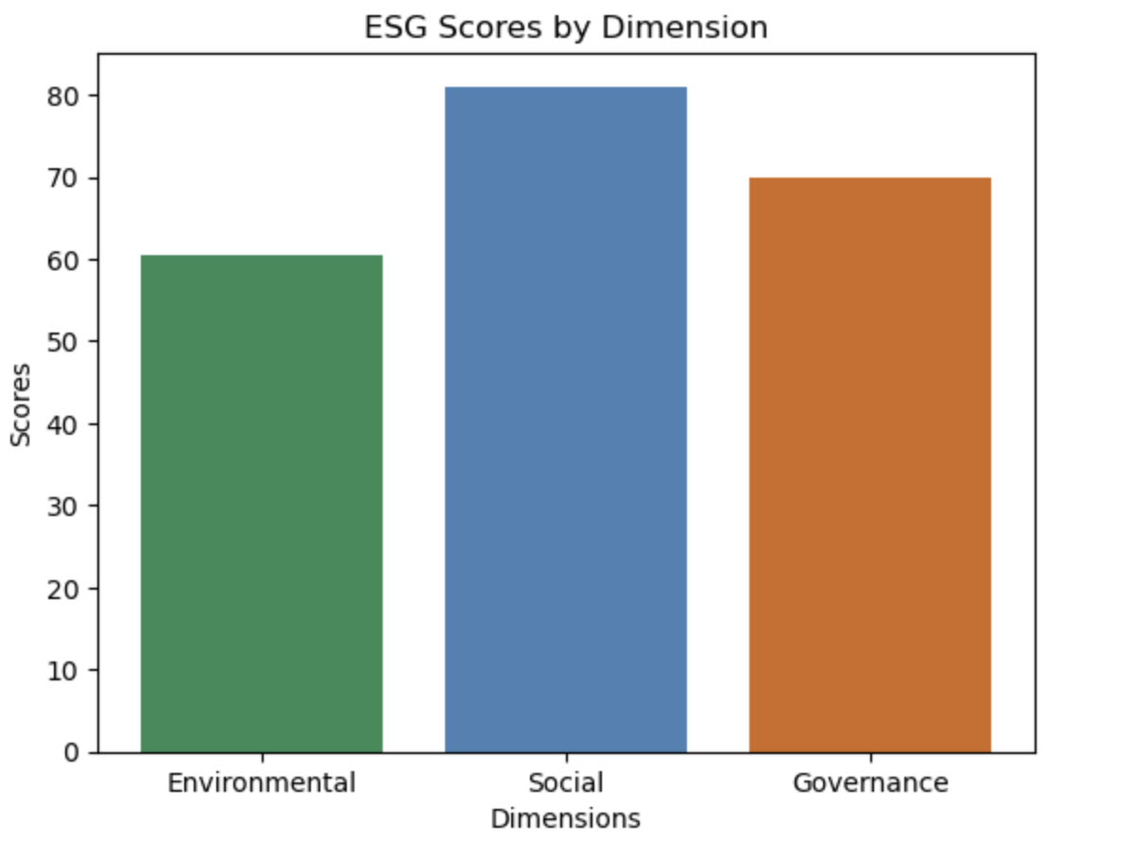
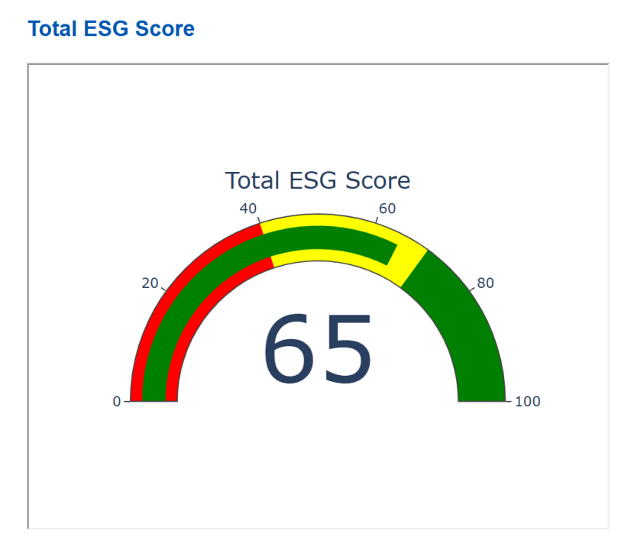
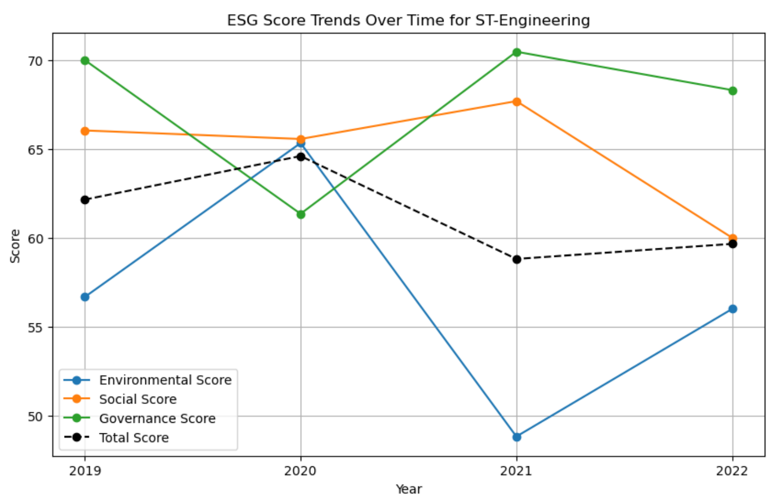
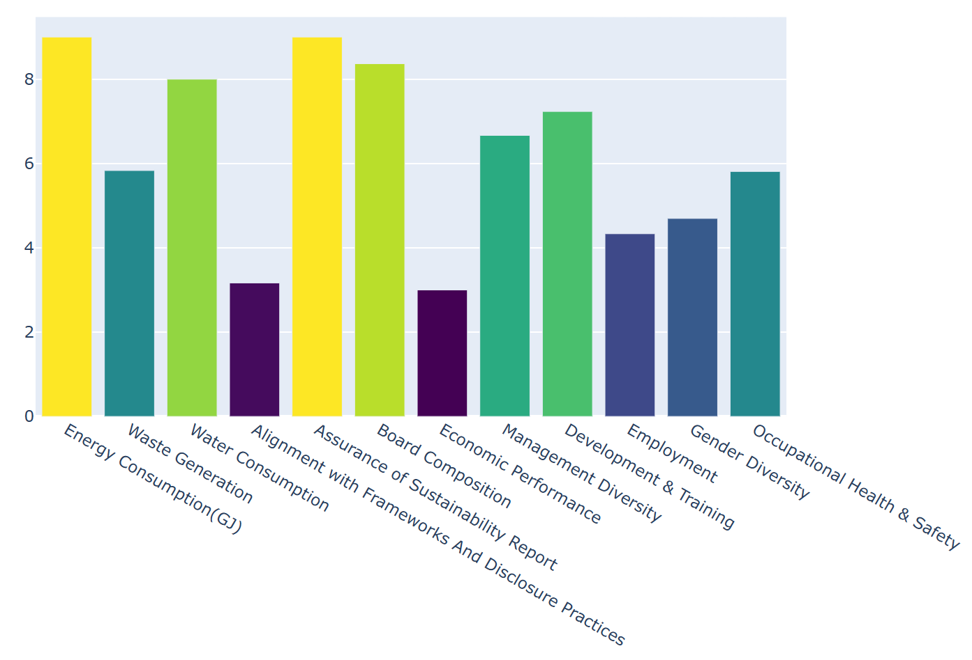
Subgroup B: Recommendations
08
Key strategies for how to present actionable ESG insights.
Different templates are available for investors, company executives, and regulators, highlighting the ESG metrics of interest to each.
Built the front-end using React and included an interactive ESG dashboard on the front-end.
ESG scoring dashboard;
ESG score bar chart;
label score bar chart;
Overall ESG score line chart

Slide 11
Integrated Strategy and Key Recommendations
09
1. Optimize Data Extraction and Processing Efficiency
End-to-End Processing Pipeline: Use NLP tools (e.g., PyPDF2 and nltk) to convert unstructured PDF reports into structured data, establishing a workflow for efficient, large-scale processing.
Increase Algorithm Adaptability: Implement transfer learning and multilingual support to handle varying ESG report standards and international content​([DSS 5105-2410] Projects)​(ESG).
2. Strengthen Data Validation and Greenwashing Detection
Data Verification: Ensure extracted data aligns with industry standards like SGX ESG indicators, using validation systems for accuracy.
Greenwashing Detection: Integrate sentiment analysis and consistency checks to identify misleading claims in ESG reports​(ESG).
3. Establish Standardized Scoring and Evaluation Framework
Industry-Specific Scoring: Develop an ESG scoring model based on SGX metrics, with weighted emphasis on environmental factors for the new energy sector.
Handling Missing Data: Exclude incomplete data entries to maintain scoring reliability and comparability​([DSS 5105-2410] Projects).
4. Enhance Data Visualization and Front-End Display
Interactive ESG Dashboard: Build a React-based dashboard with score visualizations, trends, and metrics tailored for investors, executives, and regulators.
Customizable Reports: Generate ESG performance reports customized to different stakeholder needs for actionable insights​(ESG).
5. Future Work and System Expansion
Financial Impact Analysis: Explore links between ESG scores and financial performance metrics, like volatility and capital cost.
Ongoing System Updates: Regularly update the benchmarks and scoring standards to align with evolving ESG practices and industry feedback​(ESG).

Slide 12
Potential Impact and Future Work
10
The potential impact of the system on ESG stakeholders.
Investors:
Comparative analysis of industry-specific benchmarks helps investors understand the company's performance in environmental, social, governance and other dimensions to support their investment decisions.
Provide customized ESG performance information, assess its impact on the company's financial returns, and identify long-term sustainability opportunities.
Corporate Executives:
Provide detailed ESG analysis, including the company's performance on carbon emissions, employee benefits, supply chain transparency and anti-corruption measures.
Executives can use the report to identify internal room for improvement, optimize company strategy, enhance cross-functional collaboration, and ensure effective implementation of all ESG initiatives.
Regulatory Authorities:
Export the company's overall compliance assessment in environmental, social and governance areas to help regulators understand the company's performance in complying with the latest policies and regulations.
Provides industry-average comparisons to support regulatory assessment and supervision in policy development and implementation to ensure companies meet increasingly stringent ESG compliance requirements.

Slide 13
Thank you.

